Slide 1
02.08.25 Data Analysis

Slide 2
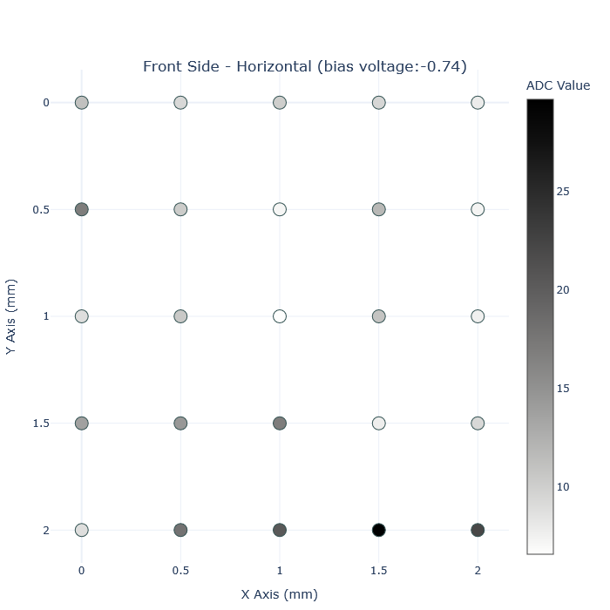
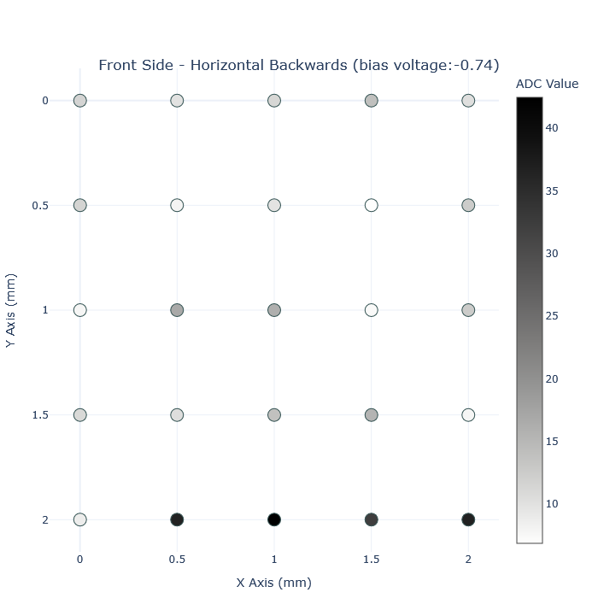
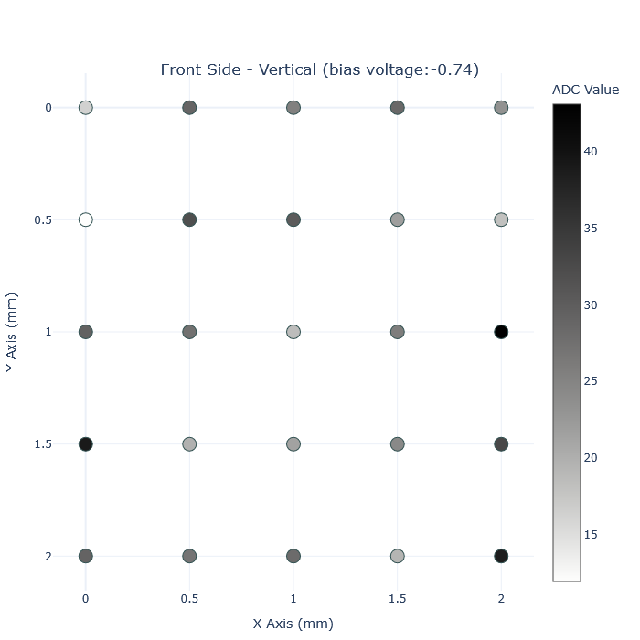
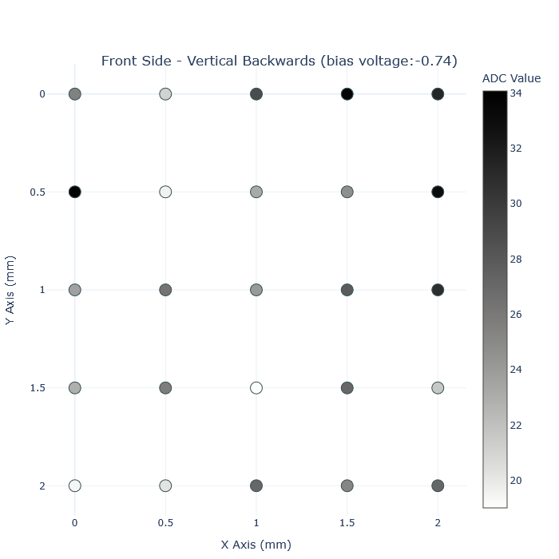
Plots of first data set (folder names: metal1,metal2,metal3,metal4)

Slide 3
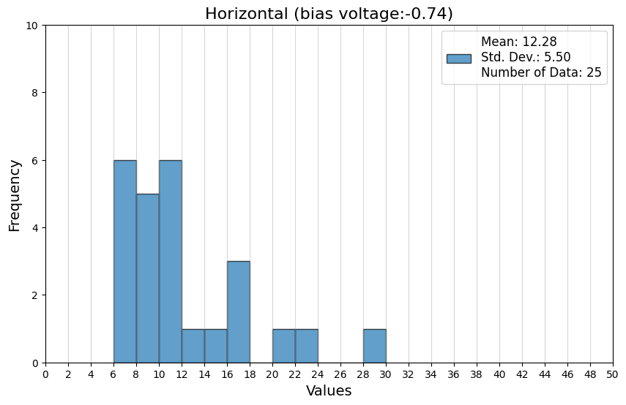
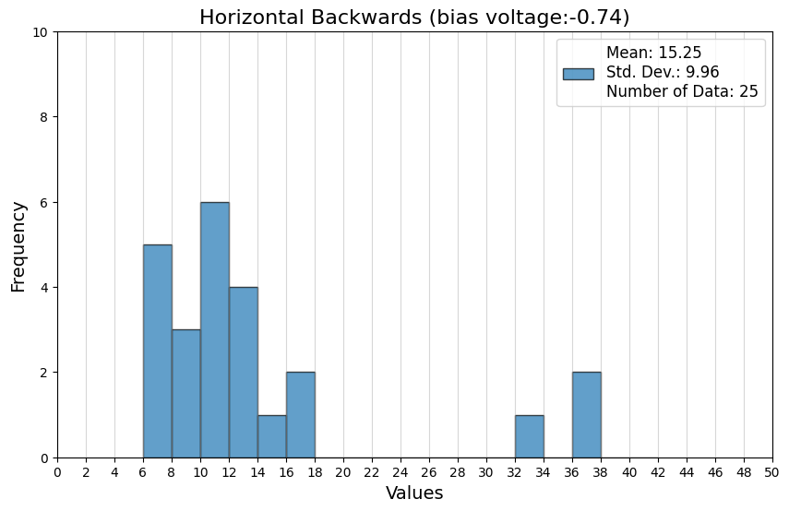
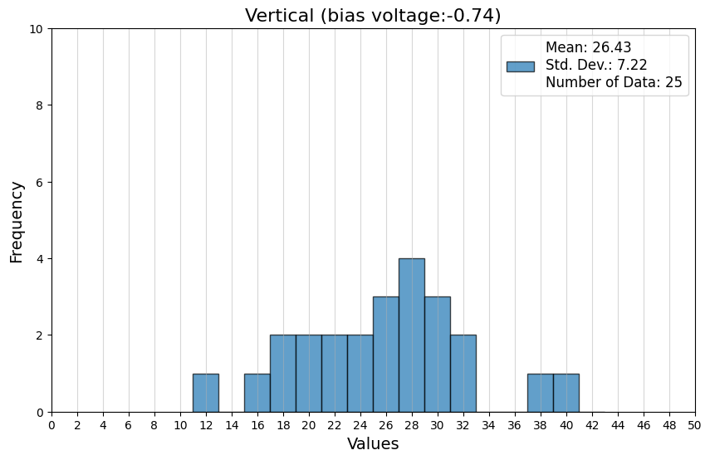
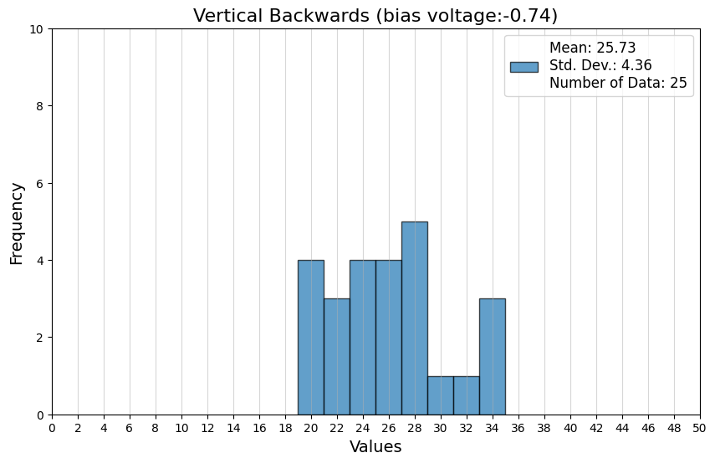
Histograms of first data set (folder names: metal1,metal2,metal3,metal4)

Slide 4
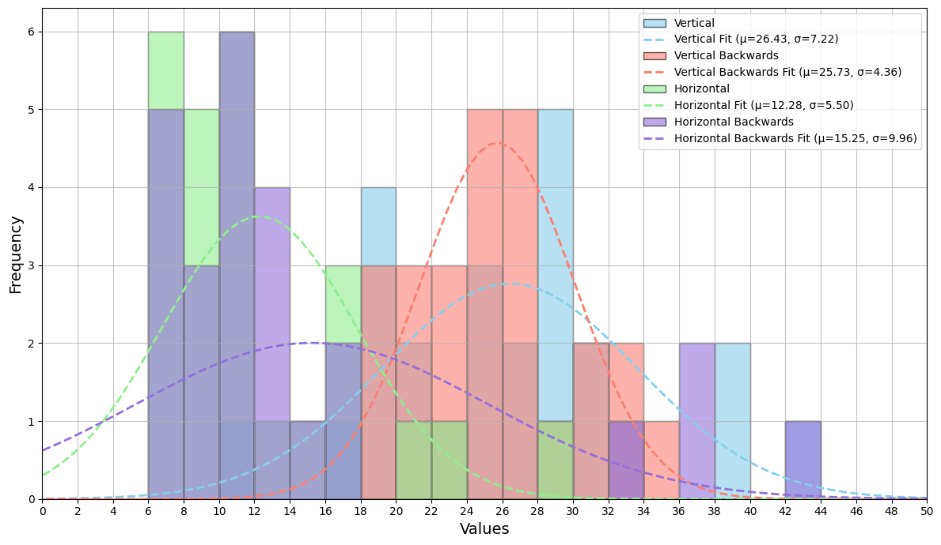
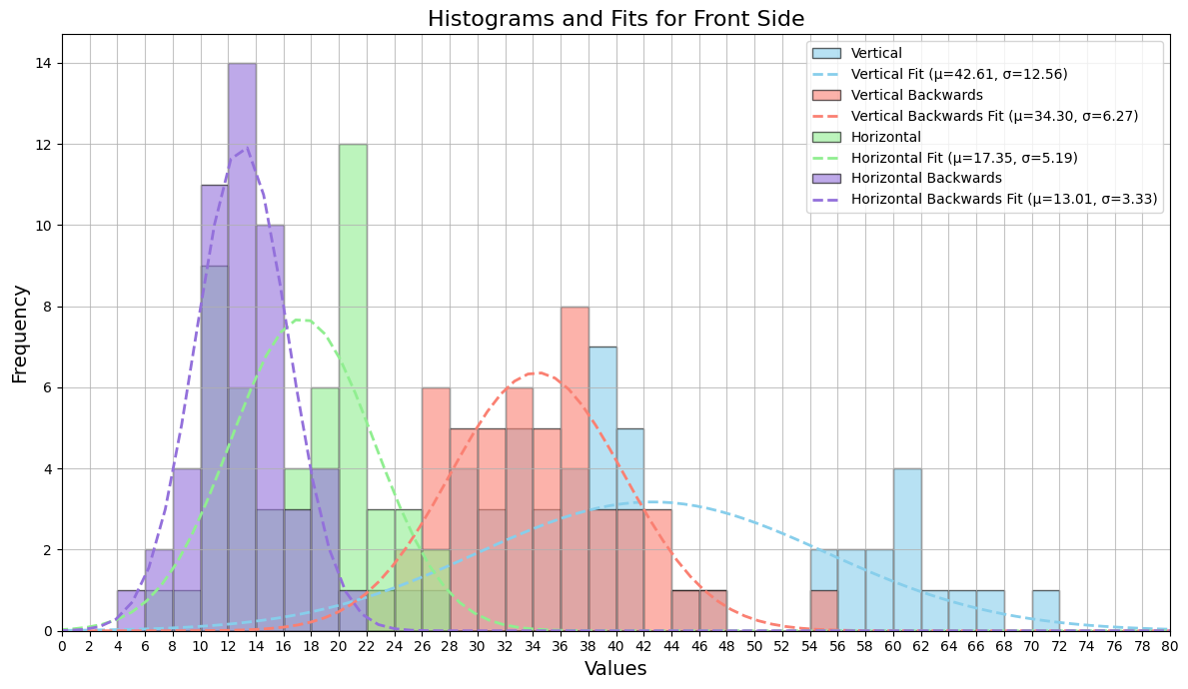
Histograms and fits of today’s data set
Histograms and fits of previous data set

Slide 5
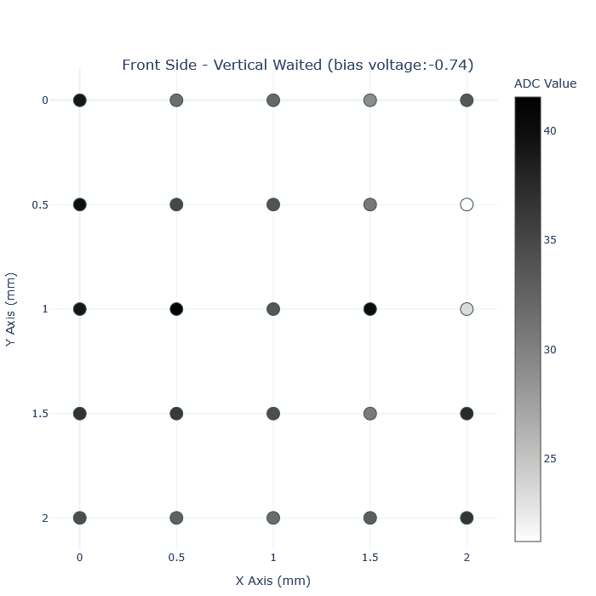

Plots of waited verticals

Slide 6
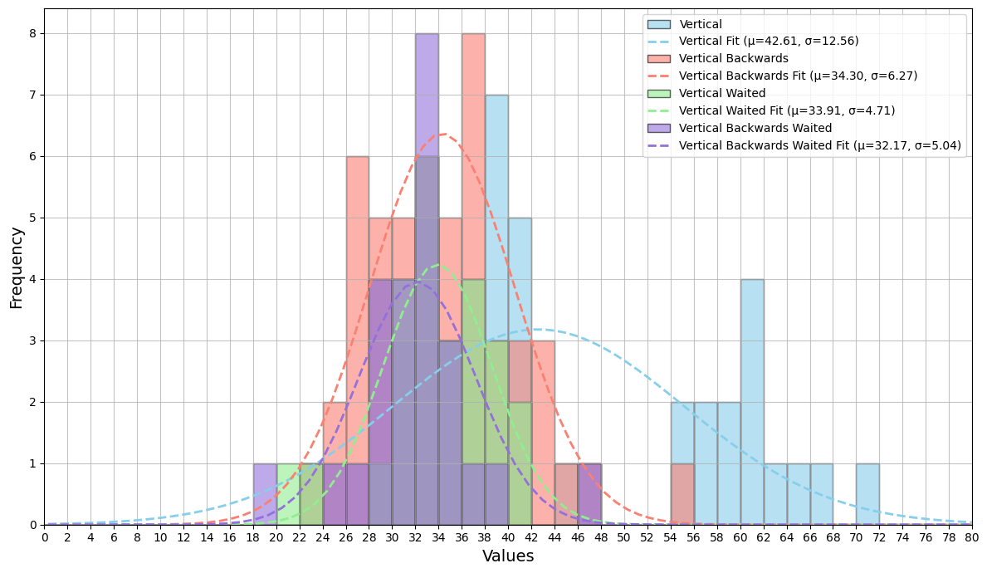
Histograms of waited verticals and previous verticals

Slide 7
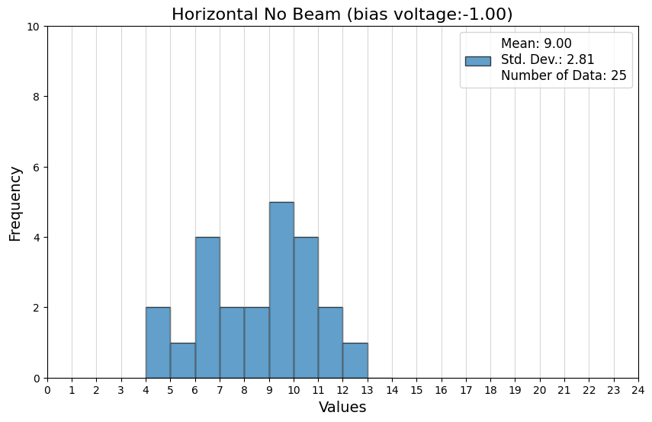
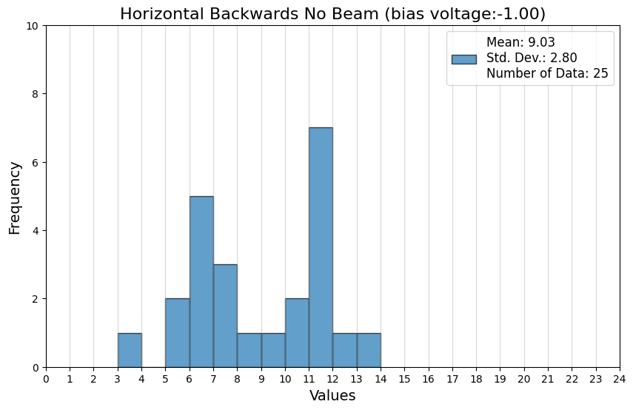
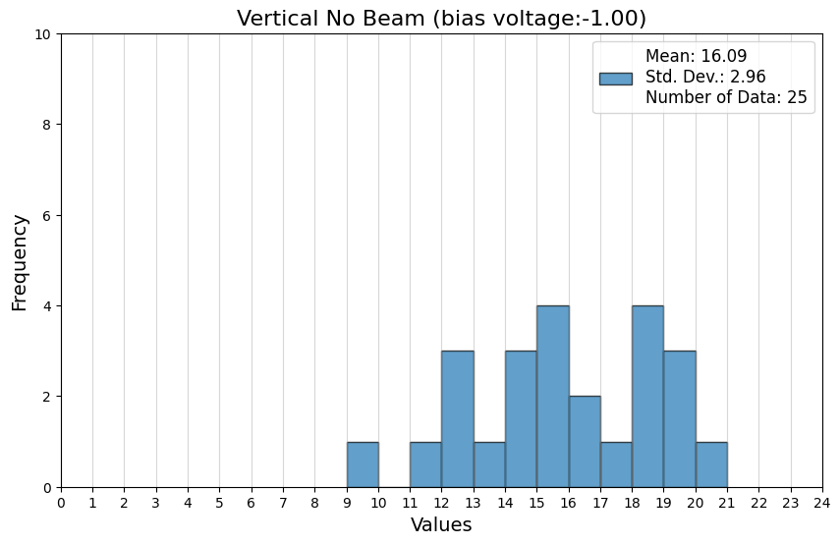
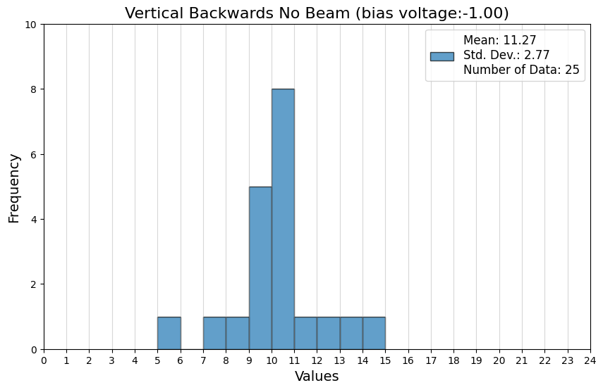
Histograms of second data set (folder names: no.beam.hor,no.beam.hor2, no.beam.ver, no.beam.ver2)

Slide 8
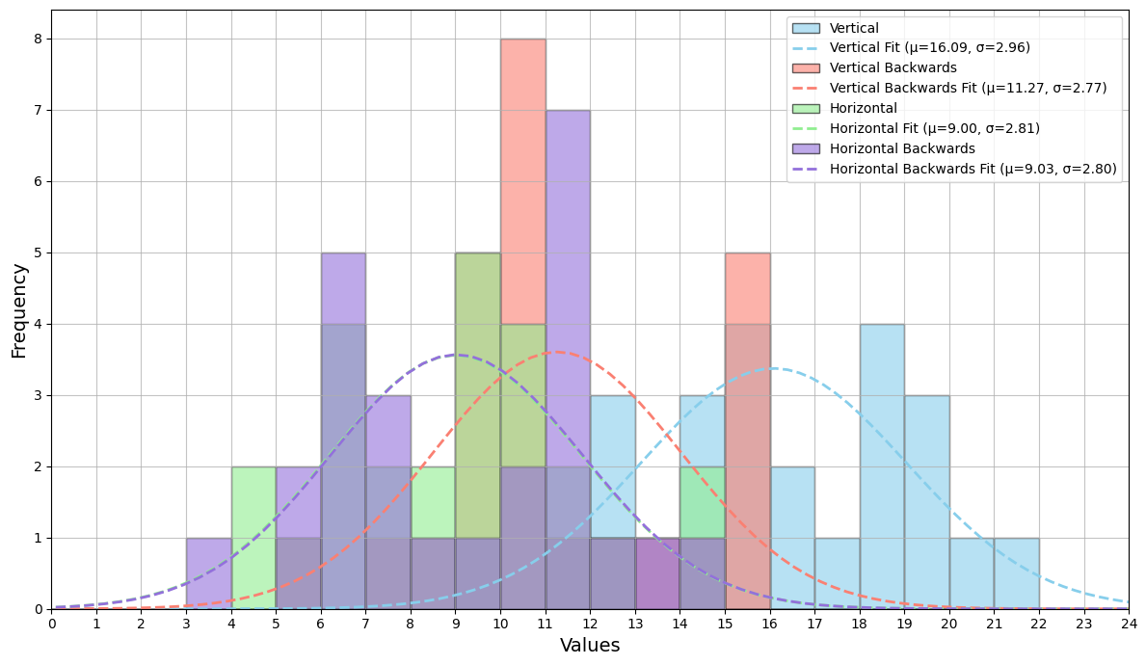
Histograms and fits of second data set (folder names: no.beam.hor,no.beam.hor2, no.beam.ver, no.beam.ver2) (Note: horizontal and horizontal backwards fits are overlapping )

